Slide 1


Name: Noman Tayyab
Roll No:FA20-BME-076
Course Title : Machine Design- II
Submitted To: Engr Haroon Mushtaq
Assignment No:02
Topic : Spur Gear Profile By Using solid works

Slide 2
Speed Reducer without inference formula at 14.5 angle
Circular pitch | 1.57
Pitch | 2
Diameter of driven | 6
P.C.D of driven | 6
A.C.D of driven | 7
D.C.D of driven | 4.75
Base circle diameter of driven | 5.8
Diameter of driver | 5
P.C.D of driver | 5
A.C.D of driver | 6
D.C.D of driver | 3.75
Base circle diameter of driver | 4.84
Tooth Thickness | 0.785

Slide 3
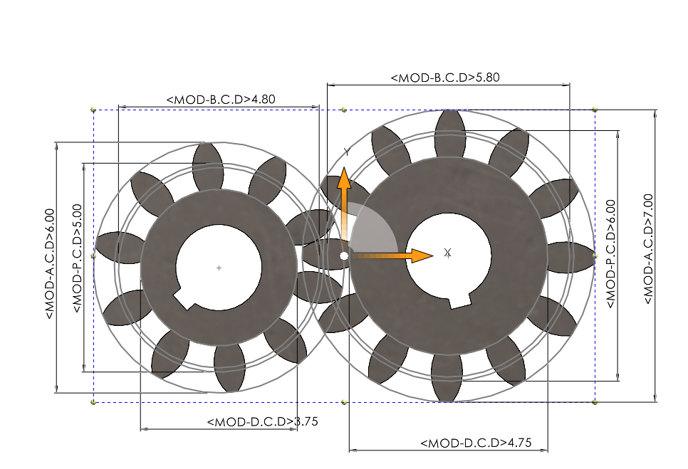
NG=12 NP=10

Slide 4
Speed Reducer without inference formula at 20 angle
Circular pitch | 1.57
Pitch | 2
Diameter of driven | 6
P.C.D of driven | 6
A.C.D of driven | 7
D.C.D of driven | 4.75
Base circle diameter of driven | 5.63
Diameter of driver | 5
P.C.D of driver | 5
A.C.D of driver | 6
D.C.D of driver | 3.75
Base circle diameter of driver | 4.69
Tooth Thickness | 0.785

Slide 5
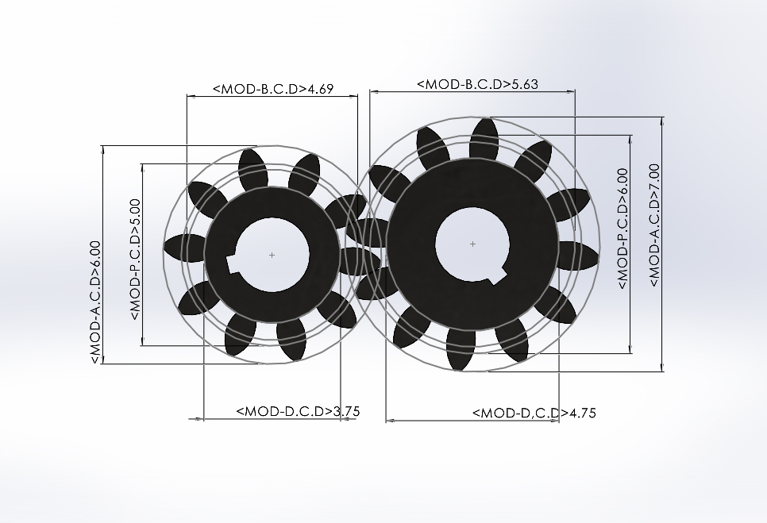
NG=12 NP=10

Slide 6
Speed Reducer without inference formula at 22.5 angle
Circular pitch | 1.57
Pitch | 2
Diameter of driven | 6
P.C.D of driven | 6
A.C.D of driven | 7
D.C.D of driven | 4.75
Base circle diameter of driven | 5.54
Diameter of driver | 5
P.C.D of driver | 5
A.C.D of driver | 6
D.C.D of driver | 3.75
Base circle diameter of driver | 4.61
Tooth Thickness | 0.785

Slide 7
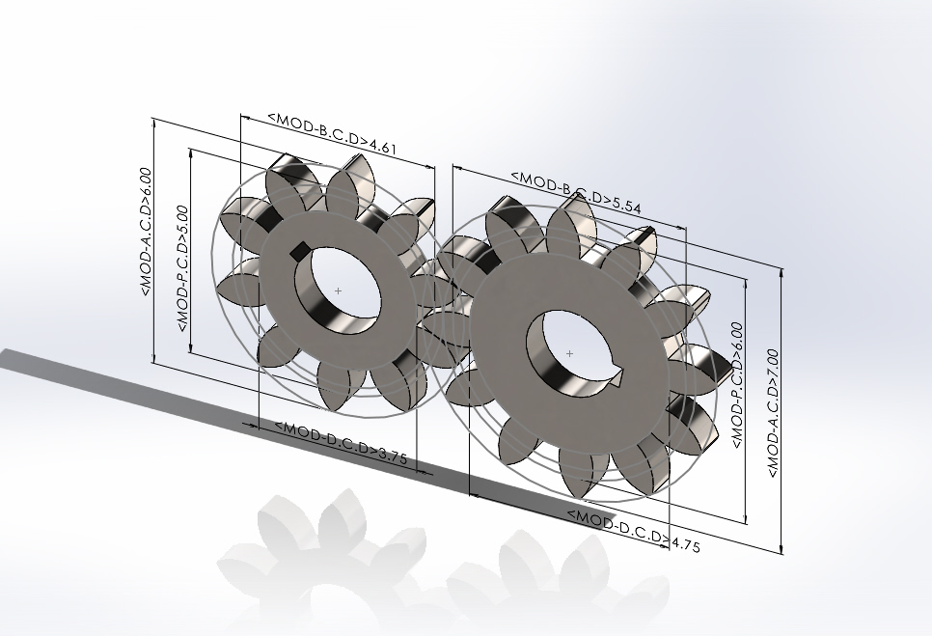
NG=12 NP=10

Slide 8
Speed Reducer without inference formula at 25 angle
Circular pitch | 1.57
Pitch | 2
Diameter of driven | 6
P.C.D of driven | 6
A.C.D of driven | 7
D.C.D of driven | 4.75
Base circle diameter of driven | 5.43
Diameter of driver | 5
P.C.D of driver | 5
A.C.D of driver | 6
D.C.D of driver | 3.75
Base circle diameter of driver | 4.53
Tooth Thickness | 0.785

Slide 9
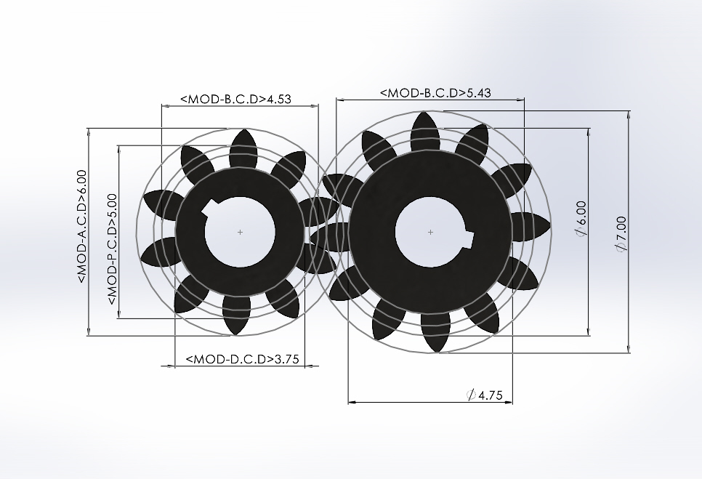
NG=12 NP=10

Slide 10
Speed Reducer with inference formula at 14.5 angle
Circular pitch | 1.57
Pitch | 2
Diameter of driven | 14
P.C.D of driven | 14
A.C.D of driven | 15
D.C.D of driven | 12.75
Base circle diameter of driven | 13.5
Diameter of driver | 11
P.C.D of driver | 11
A.C.D of driver | 12
D.C.D of driver | 9.75
Base circle diameter of driver | 10.64
Tooth Thickness | 0.785

Slide 11
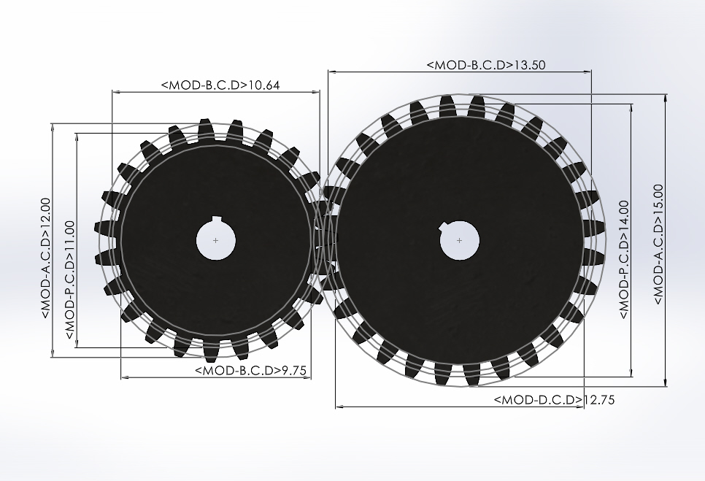
NG=28 NP=23

Slide 12
Speed Reducer with inference formula at 20 angle
Circular pitch | 1.57
Pitch | 2
Diameter of driven | 8
P.C.D of driven | 8
A.C.D of driven | 9
D.C.D of driven | 6.75
Base circle diameter of driven | 7.5
Diameter of driver | 6.5
P.C.D of driver | 6.5
A.C.D of driver | 7.5
D.C.D of driver | 5.25
Base circle diameter of driver | 6.1
Tooth Thickness | 0.785

Slide 13
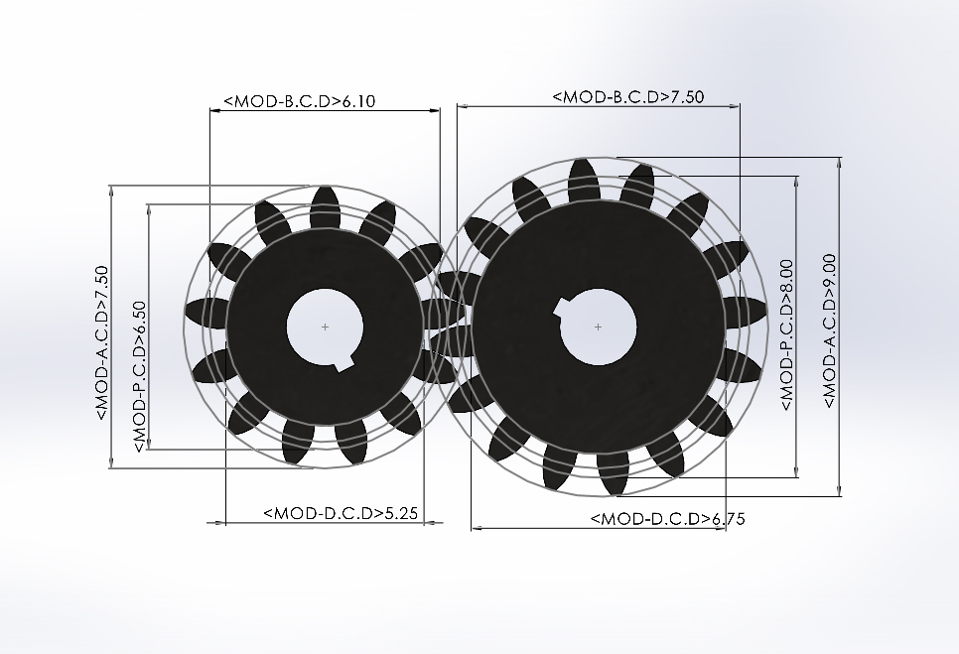
NG=16 NP=13

Slide 14
Speed Reducer with inference formula at 22.5angle
Circular pitch | 1.57
Pitch | 2
Diameter of driven | 6.5
P.C.D of driven | 6.5
A.C.D of driven | 7.5
D.C.D of driven | 5.25
Base circle diameter of driven | 6
Diameter of driver | 5.5
P.C.D of driver | 5.5
A.C.D of driver | 6.5
D.C.D of driver | 4.25
Base circle diameter of driver | 5.08
Tooth Thickness | 0.785

Slide 15
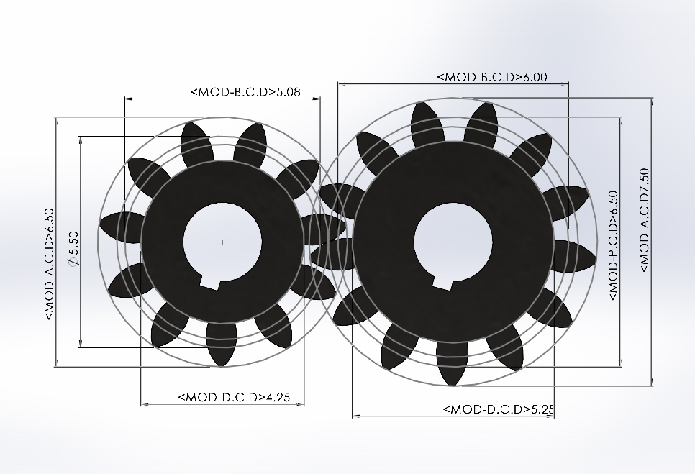
NG=13 NP=11

Slide 16
Speed Reducer with inference formula at 25angle
Circular pitch | 1.57
Pitch | 2
Diameter of driven | 5.5
P.C.D of driven | 5.5
A.C.D of driven | 6.5
D.C.D of driven | 4.25
Base circle diameter of driven | 4.98
Diameter of driver | 4.5
P.C.D of driver | 4.5
A.C.D of driver | 5.5
D.C.D of driver | 3.25
Base circle diameter of driver | 3.07
Tooth Thickness | 0.785

Slide 17
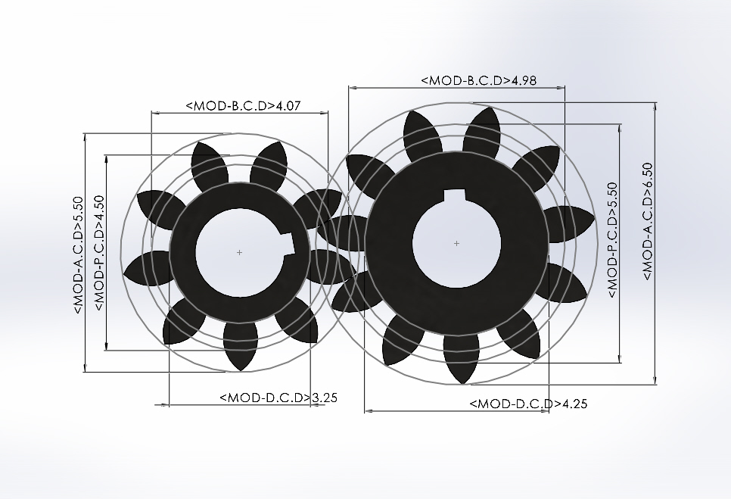
NG=11 NP=9

Slide 18
Effect of Interference Formula:
The interference formula for gears calculates the amount of overlap between the gear teeth, which can result in excessive wear and damage. Interference reduces the effective contact ratio of the gears, which is the ratio of the length of the arc of contact to the pitch circle diameter. A lower contact ratio can lead to higher contact stresses and reduce the load-carrying capacity of the gear. The interference formula can be used to adjust the gear geometry and tooth profile to minimize interference and maximize the contact ratio, resulting in a more efficient and reliable gear system.

Slide 19
Conclusion:
Interference is reduce when we used larger pressure angle.
Larger pressure angle reduce the base circle diameter.
Gear profile more involute when used large pressure angle.

